Slide 1
New Layout Process
Amir.G, Moshe.R, Tzippi ,Ron.B ,Lior.M ,Oren.S and Moris.R | September 2025

Slide 2
Motivation
Why Layout Matters
  A robust layout process ensures fewer field issues.
  Reliable products strengthen SolarEdge’s reputation.
Impact of Poor Layout
  Delays project timelines and complicates future changes.
  Increases risk of rework due to poor electrical performance and reliability.
Our Investment
  Significant time and top-tier expertise dedicated to this process.
  Expect equal commitment and active participation from all involved.

Slide 3
Motivation
Collaboration & Learning
  Diverse professional levels—everyone can contribute and learn.
  Encourage teamwork and mutual support during layout reviews.
About the Process
  This is the first iteration—improvements will follow.
  Feedback is essential to refine and optimize the workflow.
Your Role Moving Forward
  Be the spearhead of this new layout methodology.
  Act as a knowledge hub and set the standard for excellence

Slide 4
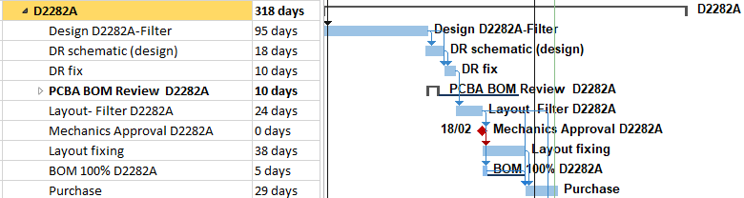
Layout Process – Key Differences and Insights
Previous Approach:
  High-level flow for Layout (no sub-task breakdown), Limited visibility into sub-task level progress, dependencies, or delays
New Layout Process:
  The layout process is broken into ~30 distinct sub-tasks. Clear ownership, timelines, and dependencies per sub-task. Enables better tracking, accountability, risk identification and mitigation.
    Implemented in Polaris project - Filter Board & Digital Board - Done
    Implemented in the Quantum project – In progress
  Key Insights:
  Sub-task breakdown enhances scheduling accuracy.
  Simplifies the detection of bottlenecks and resource gaps
  Supports data-driven decision-making during execution.
  The vision behind refining the layout process is to reduce cycle time and minimize iterations.
  We are still in a learning and optimization phase, continuously improving efficiency and accuracy.

Slide 5
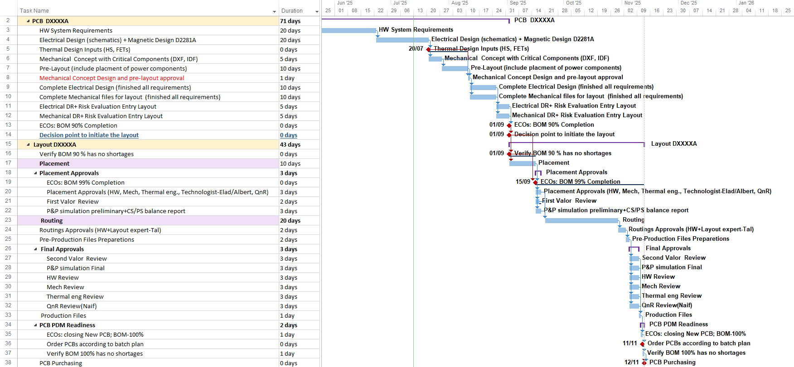
Layout Process – Overview & Implementation status
Pre-Layout & Approvals
Layout Execution
Validation & Purchasing
The presented durations should be fine-tuned for each project
The process is designed as a generic, ideal flow for board layout, but not fully applicable to initial (Proof of Concept) boards, where work is iterative and includes multiple bypasses. Still, it provides risk management visibility and helps plan future layout cycles

Slide 6
Layout Process- Key Achievements & Next Steps
Key Achievements:
  Achieved a better understanding of the end-to-end layout process
  Refined and clarified critical activities and responsibilities
  Improved planning accuracy through process insights
Next steps
  Validate the process throughout the JQ project- identify gaps, risks, bottlenecks, and improvement opportunities to enhance efficiency and clarity.
  Apply and refine the flow in additional projects to ensure scalability and adaptability across different board types.
  Define measurable KPIs to track progress, timing, and quality at each stage of the layout process.
  Collect feedback from all stakeholders (Layout, HW, NPI, etc.) to strengthen collaboration and process ownership.
  Establish lessons learned and update the flow accordingly to build a continuous improvement cycle.

Slide 7
Key Tasks in PCB Layout Process
Pre-Layout and mechanical concept -Before starting PCB Layout
Electrical Schematics + Magnetic Design
Thermal Design Inputs
Mechanical Concept with Critical Components
  Purpose: To establish a comprehensive understanding of the system’s engineering and physical requirements, and to create an initial design across all domains-electrical, magnetic, thermal, and mechanical.
  Why Included: This stage ensures all teams are aligned on a unified set of requirements, prevents cross-domain mismatches, and enables a smooth start to the development process.
Pre-Layout: (including placement of power components)
  Early placement of key power components
  Aligns mechanical and electrical zones
  Prevents layout rework and delays
Mechanical concept and pre-layout approval
  Purpose: To approve the preliminary placement of critical components and obtain conceptual approval for the mechanical design.
  Why Included: This step helps identify constraints early, prevents component conflicts, and ensures the general direction is approved before investing in full layout efforts.

Slide 8
Key Tasks in PCB Layout Process
Complete Electrical and Mechanical Design
Complete Electrical design
  Purpose: To finalize all aspects of the electrical and design according to the defined requirements.
  Why Included: Only after full design completion the layout phase can begin with confidence, minimizing the risk of late-stage changes.
Complete Mechanical Design files for layout
  Purpose: To finalize all aspects of the mechanical design according to the defined requirements. Creating complete DXF and PDF files with all the mechanical requirements ( Board outline, critical components' location, height limitations, etc.)
  Why Included: The layout designer should be familiar with all the mechanical requirements before starting the layout.
Mechanical DR + Electrical DR
  Key design checkpoints to ensure all mechanical and electrical requirements are validated before starting PCB layout.
  Enables aligning system constraints, reduces rework, and enable a smoother transition into the layout phase

Slide 9
Key Tasks in PCB Layout Process
Layout & Finalization Phase –Starting PCB Layout
Placement:
  Purpose: To place all components on the PCB according to electrical, thermal, and mechanical constraints.
  Why Included: Proper placement is critical for ensuring signal integrity, thermal performance, and manufacturability. It sets the foundation for efficient routing and minimizes design iterations later in the process.
Placement Approval:
ECOs: BOM 99% Completion: Purpose: Confirm BOM stability. Why Included: Assures no surprises during approvals. | First Valor Review: Purpose: Run DFM/DFT checks. Why Included: Detects placement manufacturability issues early.
Cross-Functional Placement Approvals: Purpose: Get feedback from HW, Mech, Thermal, Tech, QnR. Why Included: Ensures placement meets all domain requirements and less changes during late stages | Preliminary P&P Simulation – CS/PS Balance: Purpose: Simulate assembly and power balance. Why Included: Validates design for production and power

Slide 10
Key Tasks in PCB Layout Process
Layout & Finalization Phase –Starting PCB Layout
Routing + Routing Approval:
  Purpose: To connect all components electrically through optimized trace paths.
  Why Included: Routing transforms the schematic into a functional PCB. It ensures compliance with design rules, signal integrity, and electromagnetic compatibility. High-quality routing is essential for board performance and reliability.
Routing Pre-production files preparations: Silk, ICT...
Final approval:
Second Valor Review: Purpose: Final DFM/DFT validation. Why Included: Confirms design is ready for production. | Final Engineering Reviews – Ensuring Design Readiness: Purpose: Conduct final reviews across electrical, mechanical, thermal, and quality domains to validate the complete design. Why Included: These reviews ensure the board is fully functional, physically compatible, thermally reliable, and compliant with internal standards before it is moved to production.
Final P&P Simulation: Purpose: verifying the placeability of components for SMT. Why Included: Ensures smooth assembly on the production line.

Slide 11
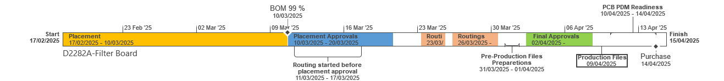
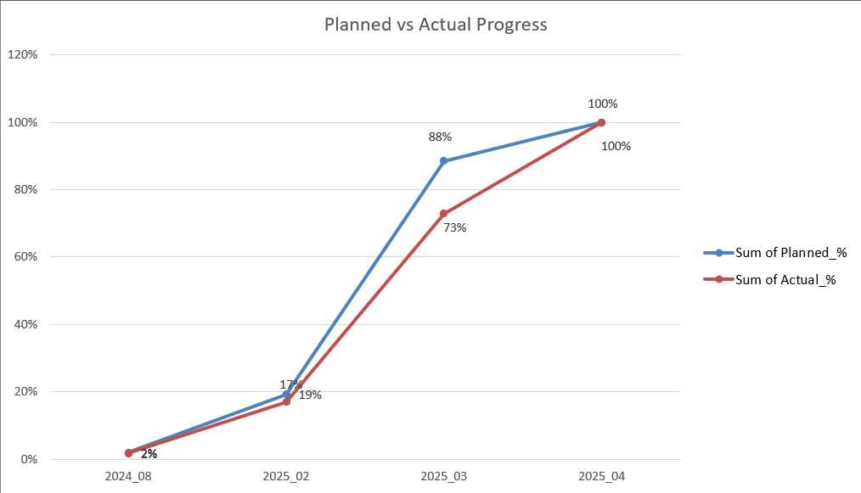
Polaris Pilot Overview- Filter Board
Timeline D2282A
Gantt Analysis:
Actual progress closely follows the planned progress, with minor deviations.
I began tracking the process from the start of the placement phase.

Slide 12

Thank you

